Slide 1

Steps to Resilience
Slide Deck Templates

Slide 2
PROJECT KICKOFF
[Project Name]
Date: [Date]
Time: [Start Time] – [End Time]

Slide 3
Welcome!
Brief welcome message from the facilitator
Objectives
Formally announce the project to the larger community.
Provide an overview of the project plan, timeline, and goals.
Introduce the project team.
Seek support from community leaders and decision-makers/elected officials (if applicable).
Ensure the project team reflects the community.

Slide 4
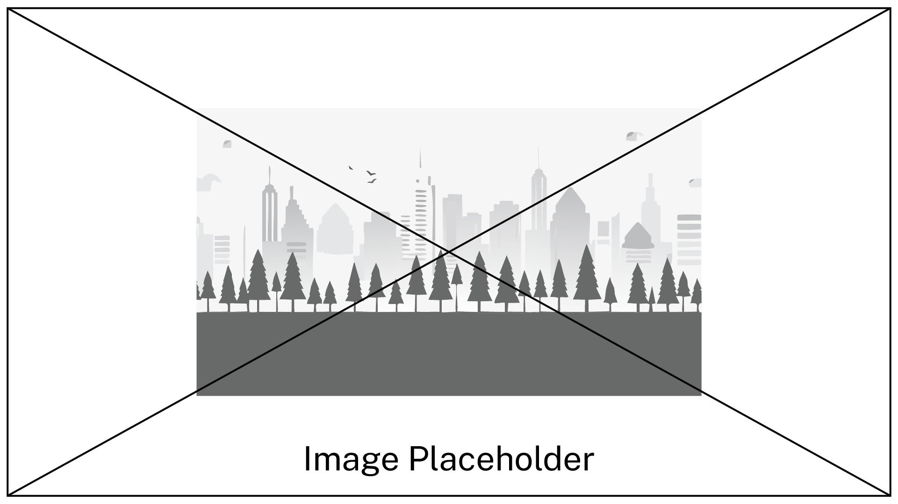
Let’s Get to Know Each Other
Prompt for round-robin introductions of attendees
Optional: Insert team photo.

Slide 5
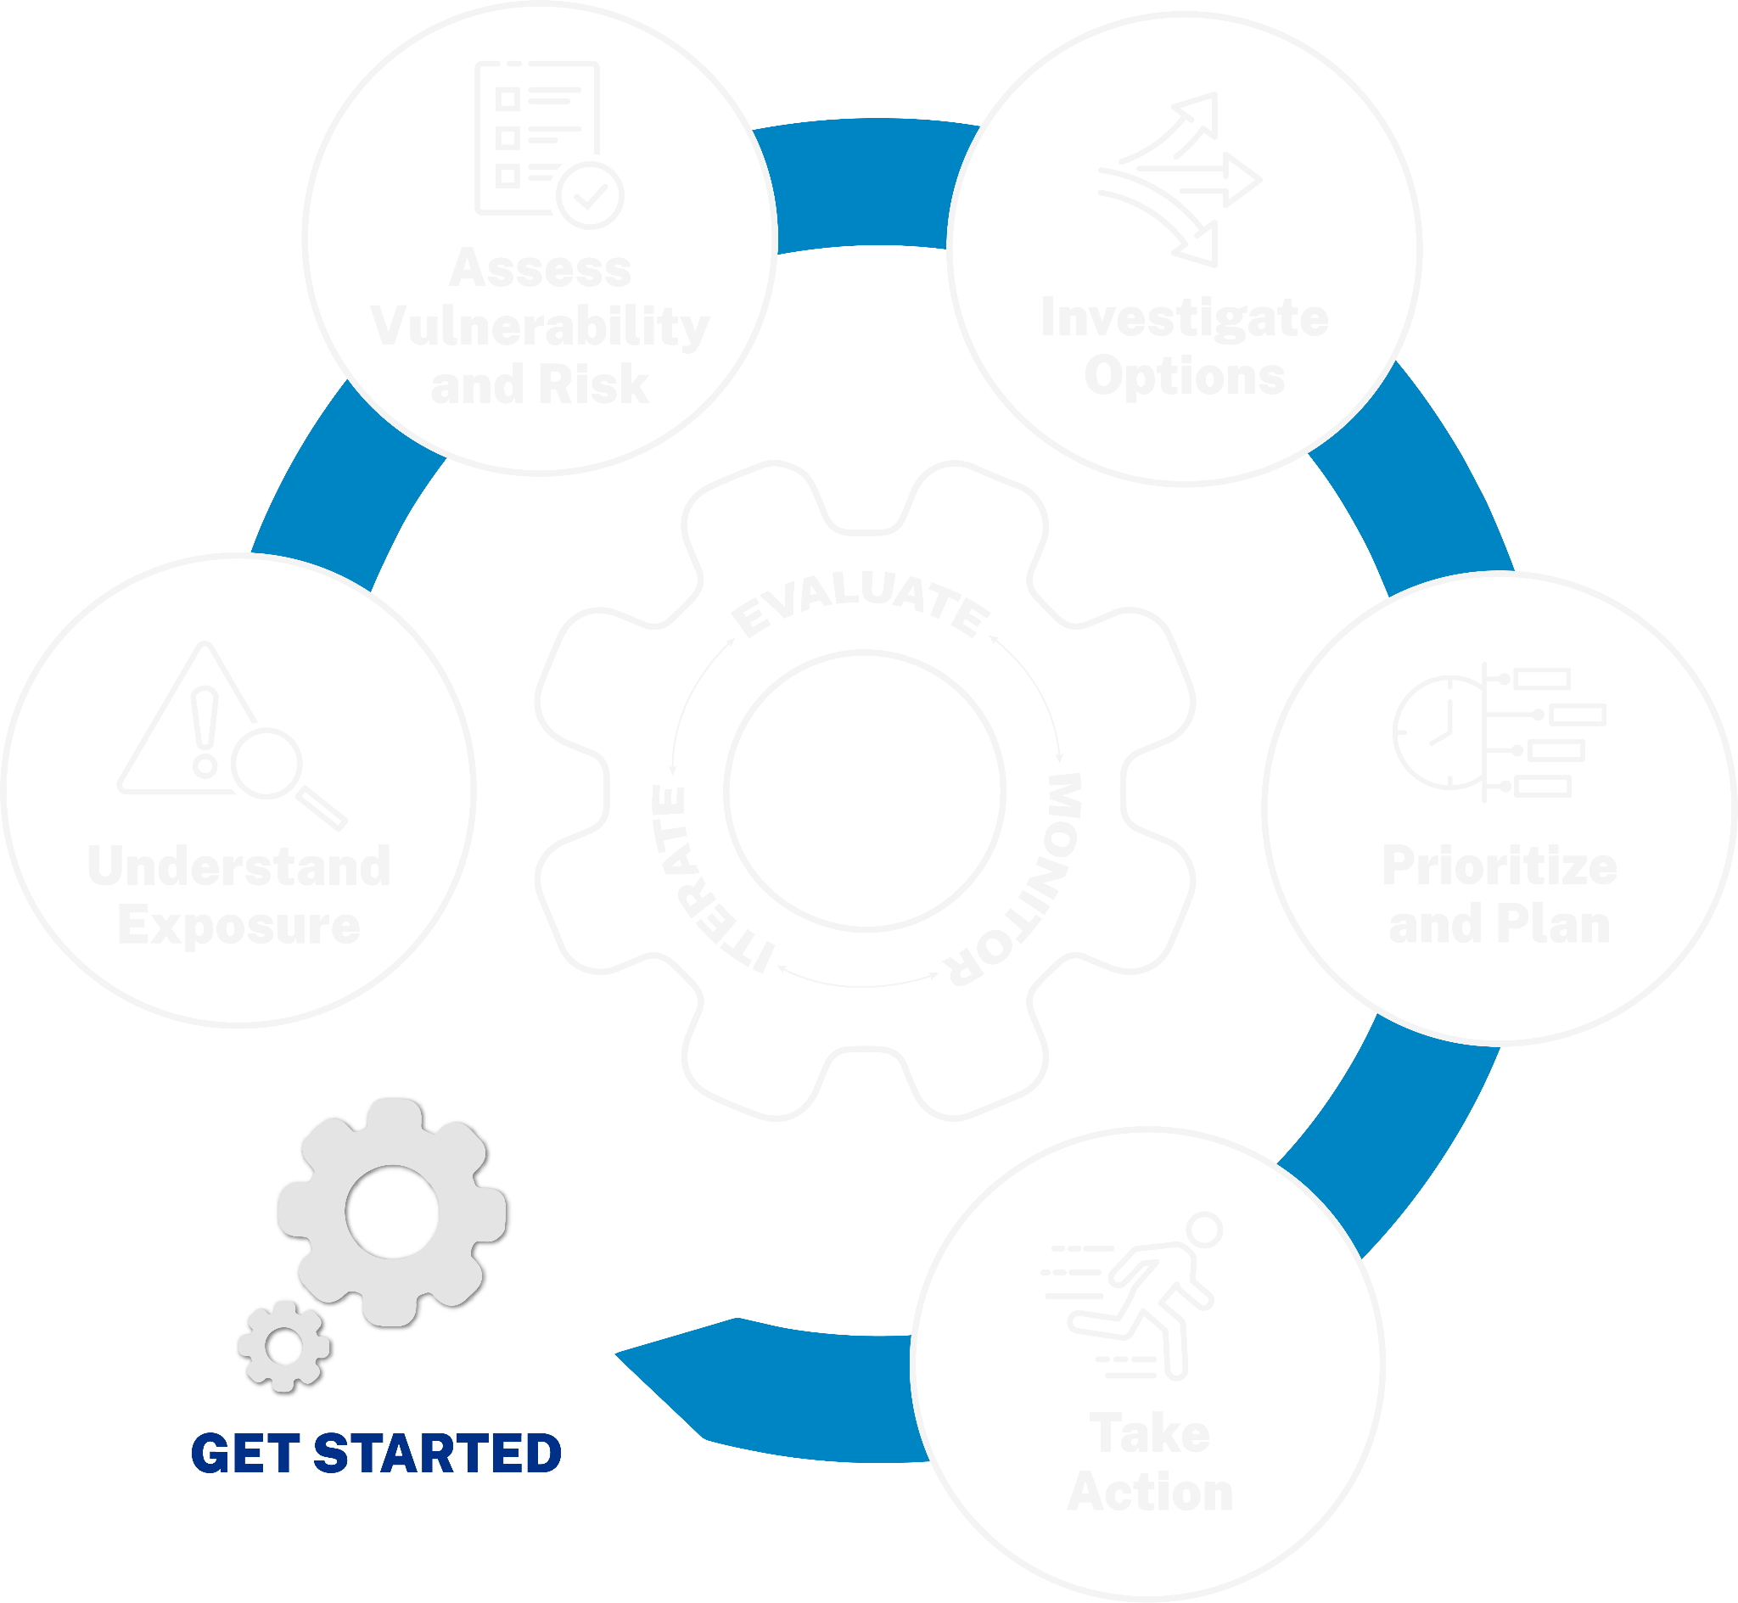
The Get Started Phase
Briefly recap the purpose and key objectives of this initial phase.

Slide 6
[Project Name]: Why This Matters
Background on the project
The need for the project
Alignment with community needs and priorities
Optional: Insert relevant data, quotes, or visuals.

Slide 7
Project Plan and Timeline
Overview of the project plan
Visual representation of the timeline (e.g., Gantt chart can be embedded or linked)
Optional: Insert a visual representation of the timeline.

Slide 8
Project Goals
Specific project goals
Key milestones

Slide 9
Meet the Project Team
Names and roles of project team members
Optional: Insert photos of team members.

Slide 10
Our Champions
Introduction of champions (if applicable) and their roles
Optional: Insert photo(s) of champions.

Slide 11
Get Involved!
Discuss opportunities for community engagement throughout the project.
How can people participate?
Optional: Insert photo(s) of the community.

Slide 12
Questions and Answers
Open the floor for questions.

Slide 13
What’s Next?
Review key decisions and action items.
Assign responsibilities and deadlines.
Determine how future information will be shared.

Slide 14

Thank You
Briefly evaluate the meeting.
Thank attendees for their participation.
Optional: Contact information
[Name]
[Email]
[Phone]

Slide 15
End of Project Kickoff Slides

Slide 16

TRANSITION SLIDE 01
This slide is used between template slide decks.

Slide 17
REVIEWING EXPOSURE
[Project Name]
Date: [Date]
Time: [Start Time] – [End Time]

Slide 18
Reviewing Exposure: Welcome!
Brief welcome message from the facilitator
Objectives
Provide an overview of identified climate-related hazards, people and community assets, and asset themes.
Review progress in collecting data on exposure to climate-related hazards.
Discuss overall community exposure and perceived risk.
Ensure all community partners are committed to moving to the next step of assessing vulnerability and risk.

Slide 19
Let’s Briefly Introduce Ourselves
Prompt for quick round-robin introductions if needed
Optional: Insert team photo.

Slide 20
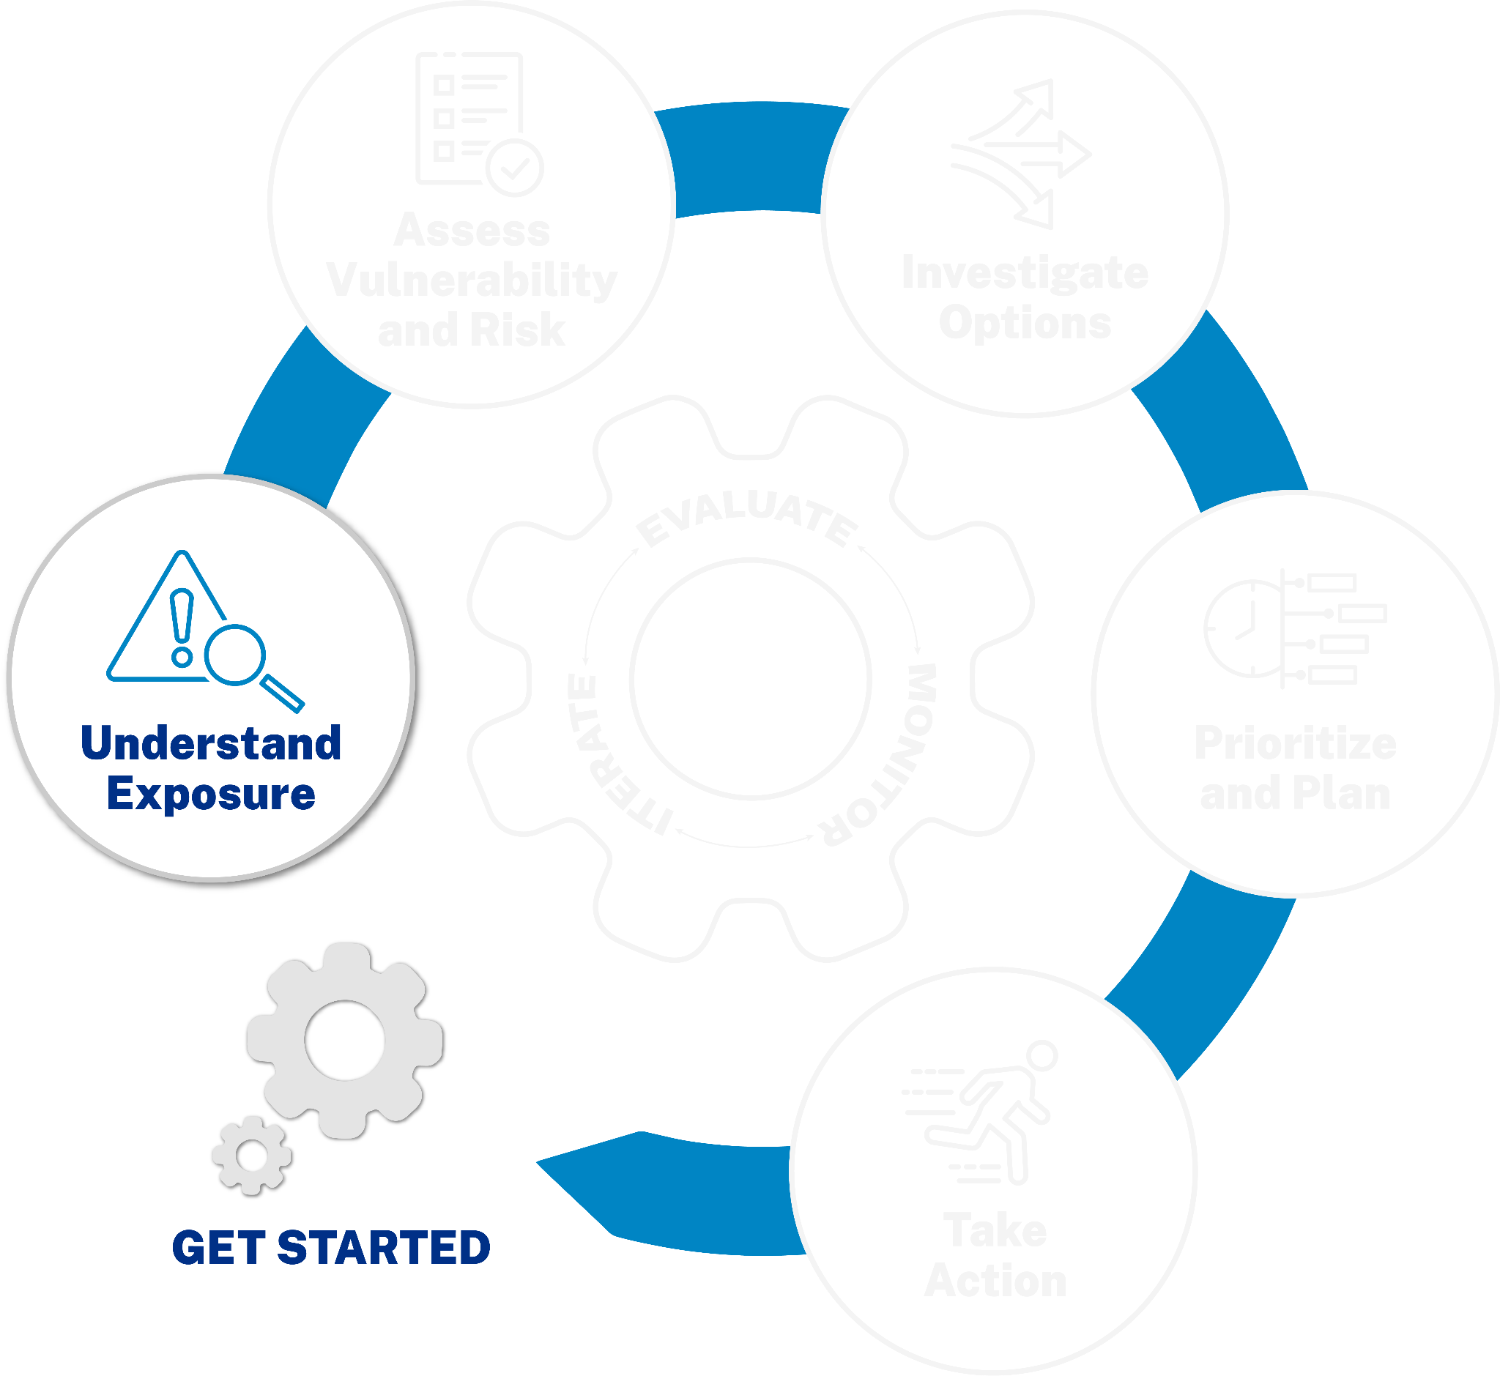
The Understand Exposure Phase
Briefly recap the purpose and key objectives of this phase.

Slide 21
Climate-Related Hazards and Stressors
Presentation of the identified climate-related hazards
Associated climate and non-climate stressors
Optional: visuals of climate-related hazards

Slide 22
Our People and Community Assets
Identified people and community assets
How these assets have been categorized into themes
Optional: examples of assets within themes

Slide 23
Exposure Data Collection: Process
Overview of the data collection process

Slide 24

Key Findings: Exposure
Key findings related to community assets’ exposure to hazards
Data gaps and limitations
Optional: charts or maps illustrating exposure

Slide 25
Key Considerations: Partner Perspectives
Part of a facilitated discussion
“Is the full range of community partner perspectives represented in identifying community concerns or people and community assets?”
Optional: Insert relevant data, quotes, or visuals.

Slide 26
Key Considerations: Valued Assets
Part of a facilitated discussion
“Are there key things the community values that are exposed to harm from climate-related hazards?”
Optional: Insert relevant data, quotes, or visuals.

Slide 27
Key Considerations: Future Conditions
Part of a facilitated discussion
“What will future conditions look like for your location during the full life cycle of the community asset?”
“Will these future conditions increase your current risk?”
Optional: Insert relevant data, quotes, or visuals.

Slide 28
Community Exposure and Perceived Risk
Discussion points on overall community exposure to climate-related hazards
Discussion on the perceived risk
Comparison of perceived risk to community vision, values, and goals from the Get Started phase
Optional: Insert photo(s) of the community.

Slide 29
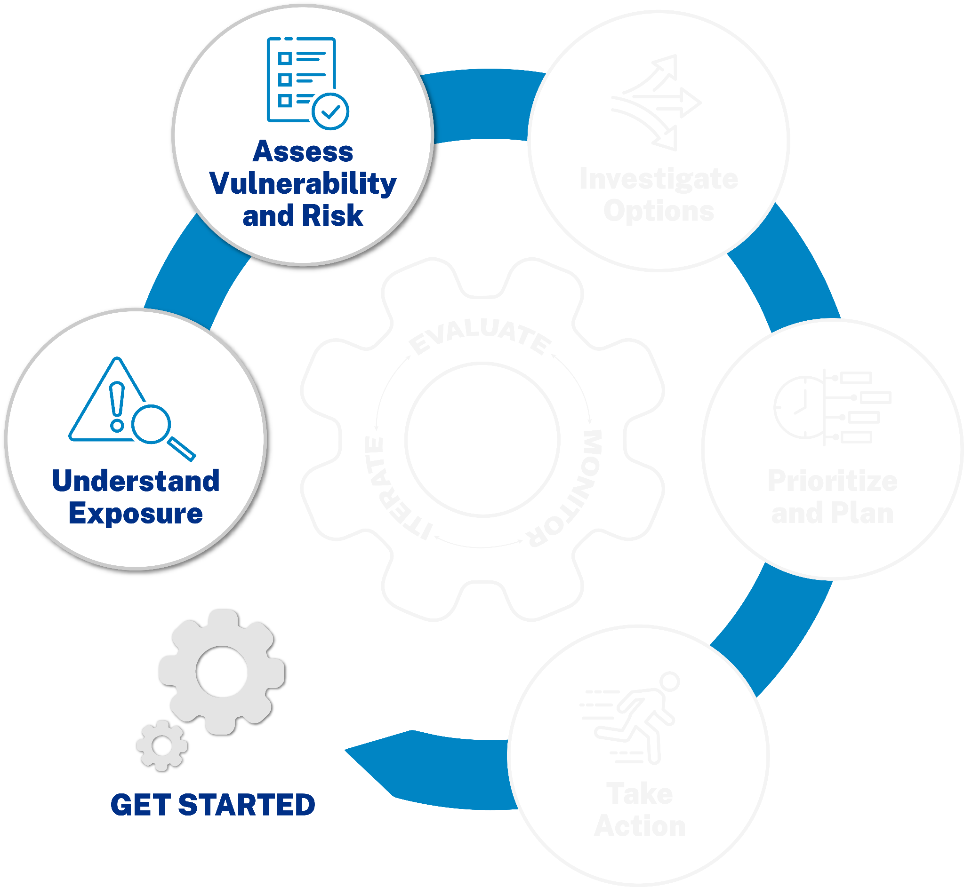
Moving Forward: Next Steps
Review key decisions and action items.
Confirm commitment to the Assess Vulnerability and Risk phase.
Assign responsibilities and deadlines.

Slide 30
Reviewing Exposure: Thank You
Briefly evaluate the meeting.
Thank attendees for their participation.
Optional: Contact information
[Name]
[Email]
[Phone]

Slide 31
End of Review Exposure Slides

Slide 32
TRANSITION SLIDE 02
This slide is used between template slide decks.

Slide 33
REVIEWING PRELIMINARY ASSESSMENT
[Project Name]
Date: [Date]
Time: [Start Time] – [End Time]

Slide 34
Reviewing Preliminary Assessment: Welcome!
Brief welcome message from the facilitator
Objectives
Share preliminary vulnerability and risk assessment results with the project team.
Review the rulesets, study area boundaries, and outputs.
Ensure the assessment factors are being applied as expected.
Gather feedback from the project team on the preliminary assessment.
OPTIONAL: Mention the Preliminary Results Feedback Worksheet.

Slide 35
Quick Introductions
Prompt for brief round-robin introductions if needed
Optional: Insert team photo.

Slide 36
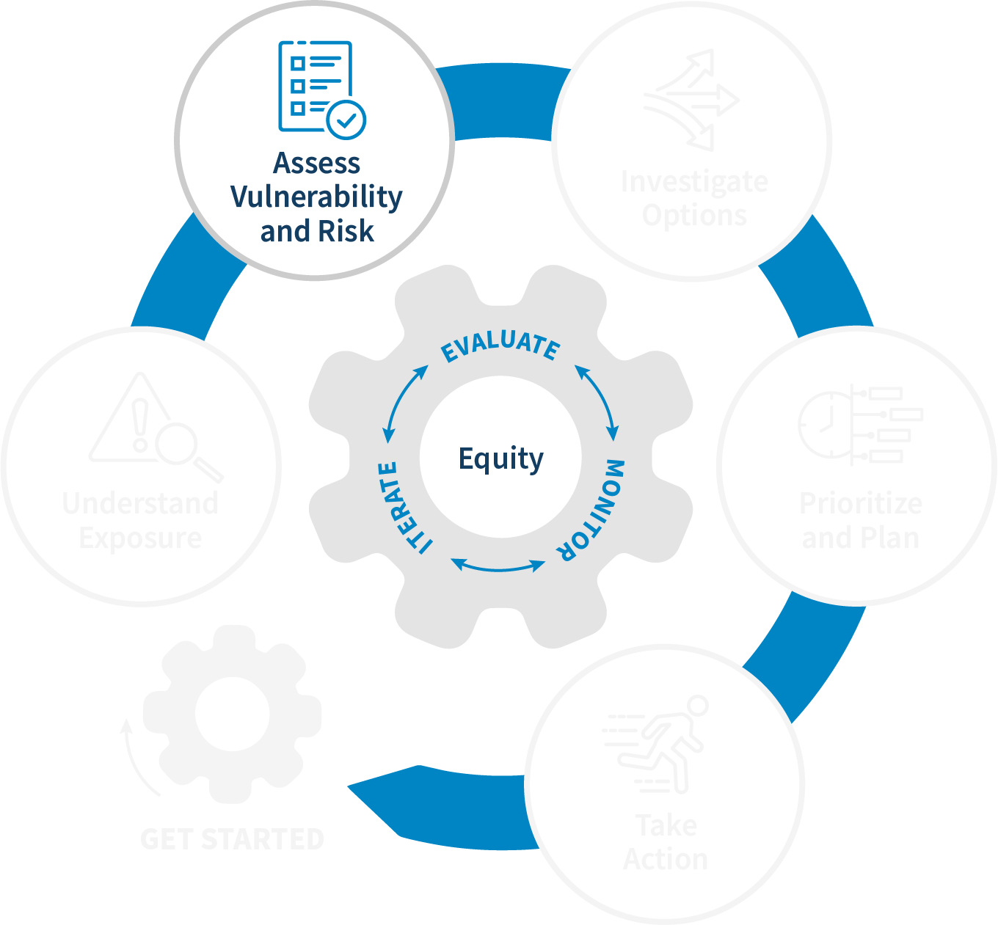
Vulnerability and Risk Assessment Process Recap
Briefly recap the steps taken in the vulnerability and risk assessment process.
Optional: a visual flowchart of the process

Slide 37
Assessment Rulesets
Review the rulesets used in the assessment.
Discuss any questions or concerns about the rulesets.
Optional: a slide for each key ruleset with a brief explanation
Optional: visuals of climate-related hazards

Slide 38
Preliminary Assessment Results: Overview
High-level summary of the preliminary findings
Note: Dedicate multiple slides to visually present the different aspects of the preliminary assessment results.

Slide 39
Vulnerability Assessment: [Specific Hazard/Asset Type]
Present vulnerability results using maps, charts, and tables.
Note: Dedicate multiple slides to visually present the different aspects of the preliminary assessment results.

Slide 40
Risk Assessment: [Specific Hazard/Asset Type]
Present risk results using maps, charts, and tables.
Note: Dedicate multiple slides to visually present the different aspects of the preliminary assessment results.

Slide 41
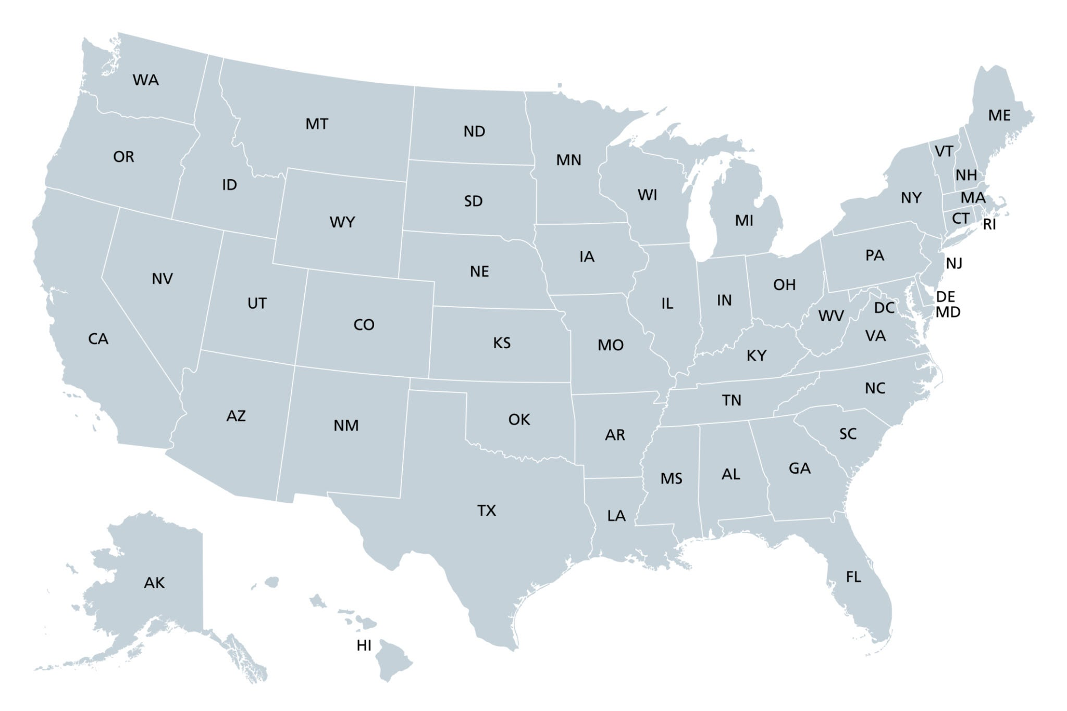
Project Area Boundaries
Display the project area boundaries.
Discussion: Are any adjustments needed? Why or why not?
Optional: a map highlighting the project area

Slide 42
Your Feedback on the Preliminary Assessment
Prompt discussion based on the Preliminary Results Feedback Worksheet.
Encourage sharing of observations, concerns, and suggestions.
How will feedback be incorporated?
Optional: Insert relevant data, quotes, or visuals.

Slide 43
What’s Next? Incorporating Feedback
Review key decisions and action items related to feedback.
Assign responsibilities and deadlines for incorporating feedback.

Slide 44
Reviewing Preliminary Assessment: Thank You
Briefly evaluate the meeting.
Thank attendees for their participation.
Optional: Contact information
[Name]
[Email]
[Phone]

Slide 45
End of Reviewing Preliminary Assessment Slides

Slide 46
TRANSITION SLIDE 03
This slide is used between template slide decks.

Slide 47
REVIEWING ASSESSMENT FINDINGS AND DEVELOPING IMPACT STATEMENTS
[Project Name]
Date: [Date]
Time: [Start Time] – [End Time]

Slide 48
Reviewing Assessment Findings: Welcome!
Brief welcome message from the facilitator
Objectives
Review the final assessment results with the full team.
Develop insights from the assessment results through the use of impact statements.
Agree on the most important climate-related impacts to address in subsequent action steps.
Address physical and social vulnerability.

Slide 49
Reviewing Assessment Findings: Quick Introductions
Prompt for brief round-robin introductions if needed
Optional: Insert team photo.

Slide 50
Final Assessment Results: Overview
High-level summary of the final vulnerability and risk assessment results.
Note: Dedicate multiple slides to visually present the different aspects of the final assessment results.

Slide 51
Vulnerability Findings
Present vulnerability findings using summary tables, planning-level maps, and asset-level maps.
Note: Dedicate multiple slides to visually present the different aspects of the preliminary assessment results.

Slide 52
Risk Findings
Present risk findings using summary tables, planning-level maps, and asset-level maps.
Note: Dedicate multiple slides to visually present the different aspects of the preliminary assessment results.

Slide 53
Understanding Impact Statements
In Nautilus’s Downtown Commercial District, a significant portion of businesses critical to the city’s economy are situated within the 100-year floodplain (specifically the tidal flooding part of this floodplain) and lack adequate flood resilience measures. The absence of flood preparedness or insurance among these businesses heightens the risk of considerable economic disruption, threatening job security, local livelihoods, and the overall economic stability of Nautilus. Efforts to enhance flood resilience in this key commercial corridor are essential to safeguarding the city’s economic health against the increasing threat of coastal flooding.
Explain the purpose of impact statements.
Key ingredients of an effective impact statement (such as What happens? To whom/what? Why is it important?)
Optional: an example impact statement

Slide 54
Workshop: Developing Impact Statements
Note: This might not be a presentation slide but a prompt.
Instructions for the team to begin developing impact statements for the most significant climate-related impacts
(If dividing into groups, a slide indicating group assignments could be here.)
Key Focus: Addressing both physical and social vulnerabilities

Slide 55
Group Presentations: Impact Statements
Each group presents their developed impact statements.
Facilitated discussion to identify common themes and prioritize impacts

Slide 56
Prioritizing Impacts
Facilitate the agreement (with the Municipal and Community Leaders and the Project Team) on the most important climate-related impacts to address in subsequent action steps.
Optional: a list of the prioritized impacts

Slide 57
Moving Forward: Action Planning
Review key decisions and action items.
Assign responsibilities and deadlines for the next steps.

Slide 58
Reviewing Assessment Findings: Thank You
Briefly evaluate the meeting.
Thank attendees for their participation.
Optional: Contact information
[Name]
[Email]
[Phone]

Slide 59
End of Reviewing Assessment Findings and Developing Impact Statements Slides

Slide 60
TRANSITION SLIDE 04
This slide is used between template slide decks.

Slide 61
Reviewing Vulnerability and Risk Findings: Laying the Foundation for Adaptation
Date: [Date]
Time: [Start Time] – [End Time]

Slide 62
Welcome! Understanding Our Vulnerabilities and Risks
Brief welcome message from the facilitator
Objectives
Ensure a shared understanding of the vulnerability and risk findings.
Identify the most pressing climate-related impacts for adaptation planning.
Connect vulnerability and risk findings to community goals and values.

Slide 63
Today’s Agenda
Review of agenda and ground rules
Overview of the Assess Vulnerability and Risk phase
Presentation of key vulnerability and risk findings
Facilitated discussion: Analyzing vulnerability drivers
Connecting impacts to community goals
Prioritization of climate-related impacts
Next steps and action items
Meeting evaluation and wrap-up
Note: Review any established ground rules for respectful and productive discussion.

Slide 64
Looking Back: Our Assessment Process
Briefly recap the purpose and methodology of the Assess Vulnerability and Risk phase.
Highlight key outputs: reports, maps, data tables, and other resources.
Optional: a visual of the assessment process

Slide 65
Key Findings: Climate-Related Hazards
Overview of the key climate-related hazards identified
Optional: maps showing climate-related hazard areas
Understanding Our Vulnerabilities and Risks

Slide 66
Key Findings: People and Community Assets Impacted
Which people and community assets are most vulnerable?
Optional: visuals of key assets
Understanding Our Vulnerabilities and Risks

Slide 67
Key Findings: Location of Impacts
Where are these impacts likely to be most significant?
Optional: maps highlighting impact zones
Understanding Our Vulnerabilities and Risks

Slide 68
Key Findings: Severity of Risk
What is the potential severity and likelihood of the identified risks?
Optional: risk matrix or summary table
Understanding Our Vulnerabilities and Risks

Slide 69
Digging Deeper: Drivers of Vulnerability
Prompt discussion about social factors contributing to vulnerability.
Prompt discussion about economic factors contributing to vulnerability.
Prompt discussion about environmental factors contributing to vulnerability.
Note: This is part of a facilitated discussion on analyzing vulnerability drivers. These could be individual slides or combined depending on the flow of discussion.

Slide 70
Connecting to Our Vision
How do the identified climate impacts potentially hinder the achievement of our community’s vision, values, and goals (established in the Get Started phase)?
Optional: a reminder of the community’s vision and values

Slide 71
Focusing Our Efforts: Prioritizing Impacts
Facilitate a preliminary prioritization of the most pressing climate-related impacts for the adaptation plan.

Slide 72
Moving Forward
Review key decisions and action items.
Assign responsibilities and deadlines.
Confirm the date and time of the next meeting (if applicable).

Slide 73
Reviewing Vulnerability and Risk Findings: Thank You
Briefly evaluate the meeting.
Thank attendees for their participation.
Optional: Contact information
[Name]
[Email]
[Phone]

Slide 74
End of Reviewing Vulnerability and Risk Findings: Laying the Foundation for Adaptation Slides

